Slide 1


Cross-Validation and Model Evaluation Techniques

Slide 2

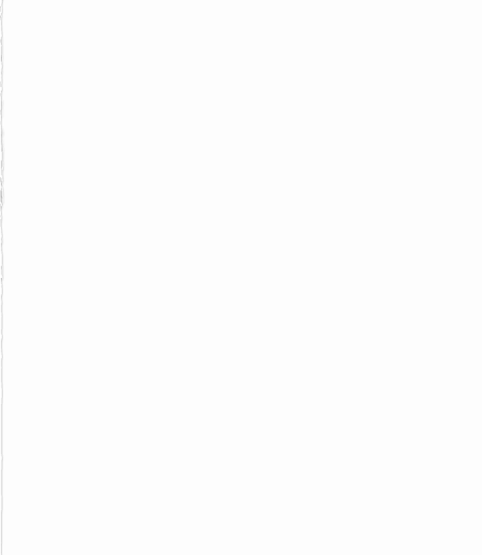
Introduction
Building a machine learning model isn’t just about training; it’s about ensuring the model performs well on unseen data. This is where cross-validation and model evaluation techniques play a crucial role.
They help measure a model’s generalization ability, reduce overfitting, and guide us in selecting the best algorithm or parameters.

Slide 3
What is Cross-Validation?
Cross-validation is a resampling method used to evaluate models on different subsets of the dataset.
Instead of using a single train-test split, the data is divided into multiple folds.
The model is trained on some folds and tested on the remaining fold, repeating until all folds have been used.

Slide 4
Common Cross-Validation Techniques
K-Fold Cross-Validation: Dataset split into k folds, repeated k times.
Stratified K-Fold: Ensures class proportions remain consistent in each fold.
Leave-One-Out (LOO): Each data point is used once as a test set, useful for small datasets.
Train-Test Split: Simple split for quick evaluation.

Slide 5
Model Evaluation Metrics
Depending on the problem type:
Classification Metrics: Accuracy, Precision, Recall, F1-Score, ROC-AUC
Regression Metrics: Mean Squared Error (MSE), Root Mean Squared Error (RMSE), Mean Absolute Error (MAE), R² Score
Choosing the right metric depends on the business problem and dataset characteristics.

Slide 6
Why Use Cross-Validation and Evaluation?
Provides a more reliable estimate of model performance
Reduces overfitting by testing on multiple data subsets
Ensures the chosen model can generalize to new, unseen data
Helps compare multiple models fairly

Slide 7
CONCLUSION
Cross-validation and model evaluation techniques are essential steps in the machine learning workflow. They ensure that models are not only accurate on training data but also robust, reliable, and ready for real-world deployment.

Slide 8
THANK YOU
If you have any doubts
thahliyamist@gmail.com

